Slide 1
Waikawau Bay Reserve
Community Engagement Report
June 2025

Slide 2
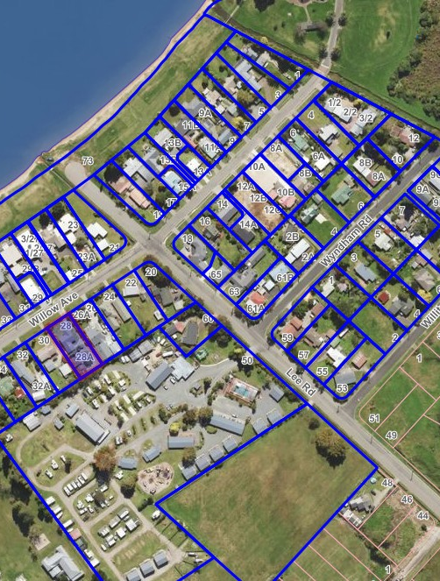
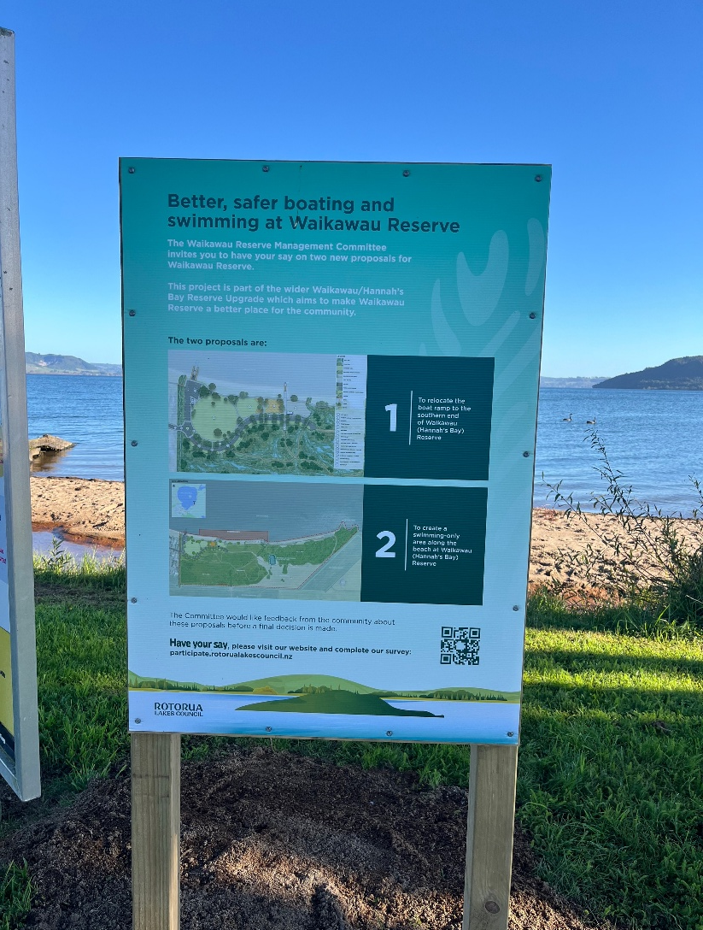
Community Engagement
Approx 100 letters were delivered to residents in homes outlined. The letter included background information and a link to the survey.
Emails were sent to the property owners in this area.
Emails were sent to local marae and community groups inviting them to complete the survey.
A corflute sign was erected at the current boat ramp site for the duration of the survey period.
An ad was placed in the Inside Eastside community publication with a QR link to the survey. This publication is delivered free to 4000+ homes in Lynmore, Ngapuna, Owhata, Holdens Bay, Hannahs Bay and Brunswick Park.

Slide 3

Social Media Engagement
 | Organic | Paid
 | Facebook |  | Instagram | Tiktok | Facebook | Instagram
 | Story (Meme) | Organic post (May 14) | Organic post (may 14) | Organic video (meme) | $65.09 | $39.25
Views | 1800 | 4200 | 169 | 250 | 15231 | 7715
Reach | 1600 | 2500 | 130 | - | 6085 | 4762
Engagements | 7 | 43 | 1 | 5 | 252 | 456
Clicks | - | - | - | - | 641 | 117

Slide 4

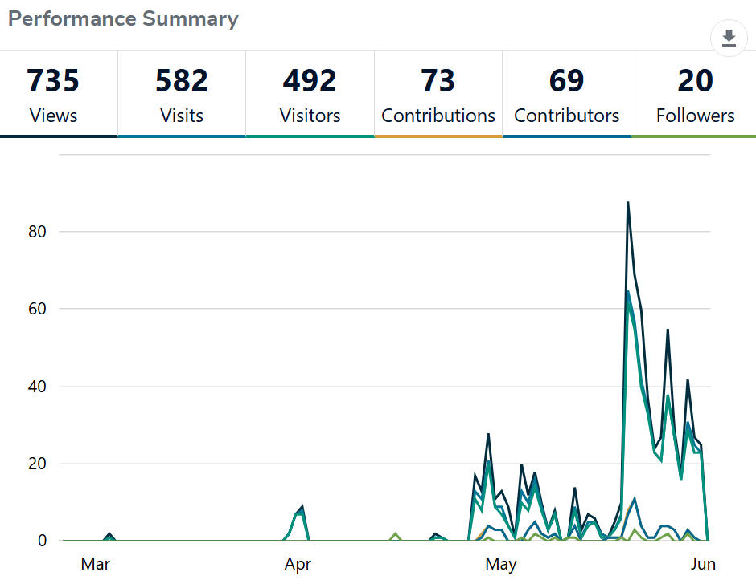
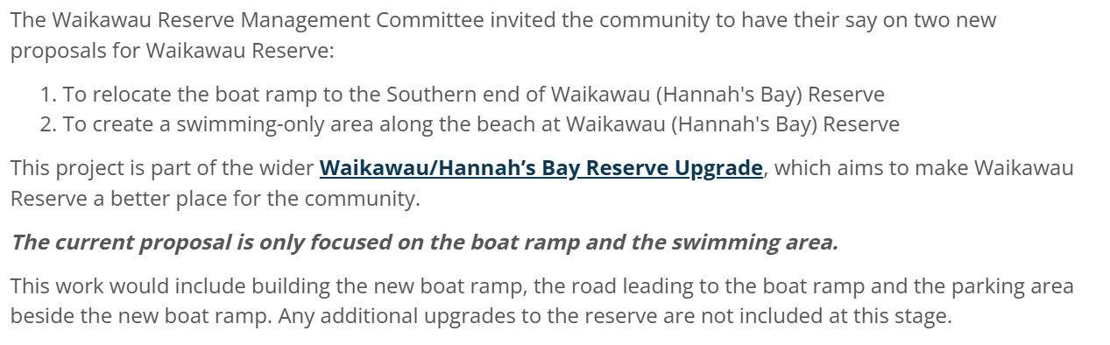
Data Collection
Background to the proposal and a questionnaire requesting feedback was uploaded to Social Pinpoint, under the RLC branding, Participate | Whakapuakina mai.
Analysis was done using Displayr software. This included AI analysis of the open-ended questions.
Arrows beside numbers in the charts and tables indicate statistical significance.

Slide 5
Support for Moving the Boat
Do you support the proposal to move the boat ramp at Waikawau Reserve from its current position to the southern end?
How come? Why do you support / not support the proposal to move the boat ramp at Waikawau Reserve?
N=73
N=55

Slide 6
Support for Moving the Boat Ramp
We looked at this data by demographics, where they lived, frequency of using the reserve, and what they use it for. We urge caution in interpretation because the sample sizes are small.
  Support for moving the boat ramp is significantly stronger among the youngest age group (30 to 44 years). There were no differences by ethnicity or gender.
  There were no differences by frequency of use.
  Those who use the reserve for swimming, picnics and the playground tend to favour moving the ramp (around 60/40). But this is not statistically significant due to small sample sizes. Only 41% of boaties supported the proposal.
  We had 17 responses from people who said they lived in Hannahs Bay. Less than a quarter supported the proposal. Their main reasons were cost, and concerns about privacy.

Slide 7
Support for a Swimming Only Area
Do you support the proposal to create a swimming-only area where the boat ramp used to be?
How come? Why do you support / not support the proposal to create a swimming-only area?
N=67
N=49

Slide 8
Support for the Swimming Only Area
We looked at this data by demographics, where they lived, frequency of using the reserve, and what they use it for. We urge caution in interpretation because the sample sizes are small.
  Support for the swimming only area is stronger among the youngest age group (30 to 44 years). There were no differences by ethnicity or gender.
  There were no differences by frequency of use.
  Those who use the reserve for swimming, picnics and the playground tend to favour the swimming only area (around 70/30). This is not statistically significant due to small sample sizes. Only 45% of boaties supported the swimming only area.
  We had 17 responses from people who said they lived in Hannahs Bay. Around 4 in 10 supported the proposal. Their concerns were cost, and that the water quality in the bay was not suitable for swimming.

Slide 9
Final Comments by Votes
Any final thoughts or comments? - Categorized by Votes
Column % | Support for Moving Waikawau Reserve Boat Ramp |  | Support for Swimming-Only Area Proposal
 | Yes, I support this proposal | No, I do not support this proposal | Yes, I support this proposal | No, I do not support this proposal | I don't know / unsure
Recreational use and access | 38% | 25% | 43% | 24% | 0%
Concerns about spending and project necessity | 6% ↓ | 33% | 5% ↓ | 47% ↑ | 50%
General feedback and miscellaneous comments | 19% | 25% | 24% | 12% | 50%
Community consultation and involvement | 19% | 21% | 19% | 24% | 50%
Infrastructure and design suggestions | 13% | 29% | 19% | 29% | 0%
Support for development and improvements | 44% ↑ | 4% ↓ | 29% | 6% | 0%
Safety and security issues | 6% | 21% | 14% | 18% | 0%
Environmental concerns and pollution | 6% | 21% | 19% | 12% | 0%
Cultural and historical considerations | 13% | 8% | 5% | 18% | 0%
Local business and economic impact | 0% | 4% | 5% | 0% | 0%
Column Sample Size | 16 | 24 | 21 | 17 | 2
sample size = 44; total sample size = 73; 29 missing; 95% confidence level

